Slide 1
ATAI
Advanced Technique of Artificial Intelligence
ATAI
ChongqingUniversity _{AdvancedTechniqueof}
of Technology Artificial Intelligence
Chongqing University of
Technology
Chongqing University ^{ATAI}
_{of Technology} Advanced Techniqueof
Artificial Intelligence
Chongqing University of Technology
Chongqing University of Technology
PlugIn Diffusion Model for Embedding Denoising
in Recommendation System
Code : None
—— SIGIR’2024
Reported by Yang Jiang
1

Slide 2
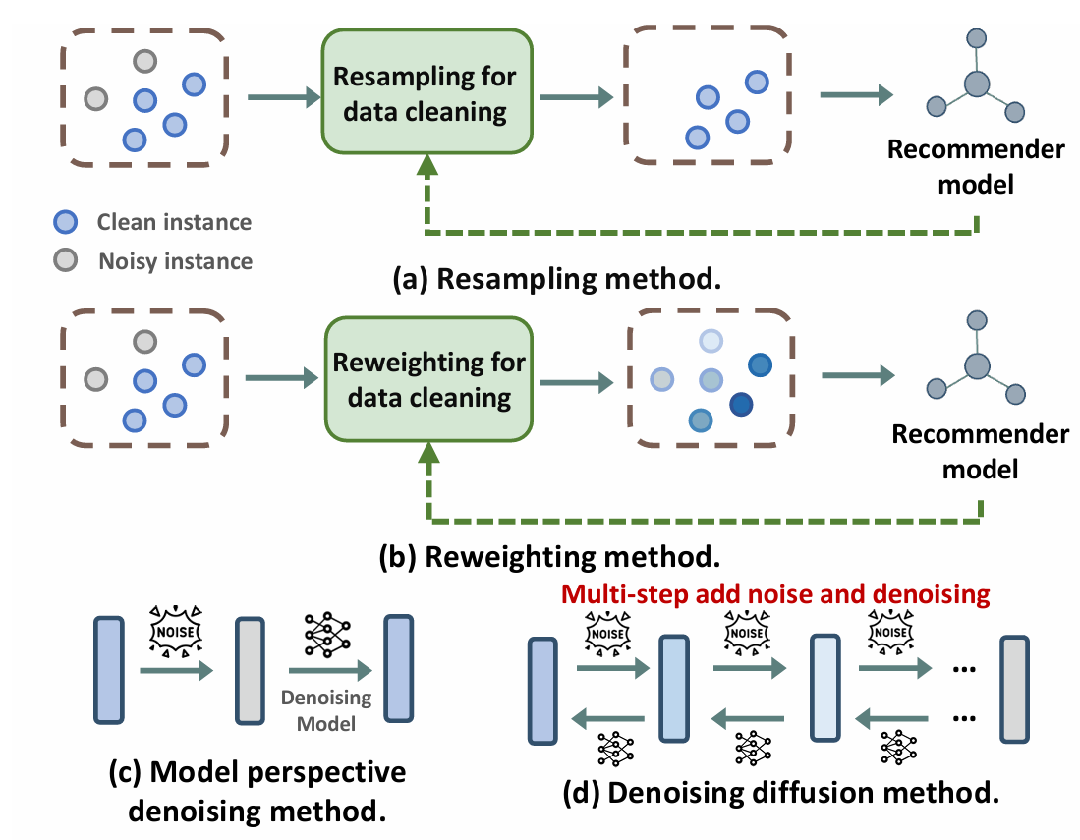
ATAI
Advanced Technique of Artificial Intelligence
ATAI
ChongqingUniversity _{AdvancedTechniqueof}
of Technology Artificial Intelligence
Chongqing University of
Technology
Chongqing University ^{ATAI}
_{of Technology} Advanced Techniqueof
Artificial Intelligence
Chongqing University of Technology
Chongqing University of Technology
Introduction
While most research efforts focus on mitigating noise through data cleaning methods like resampling and reweighting, these approaches often rely on heuristic assumptions.

Slide 3
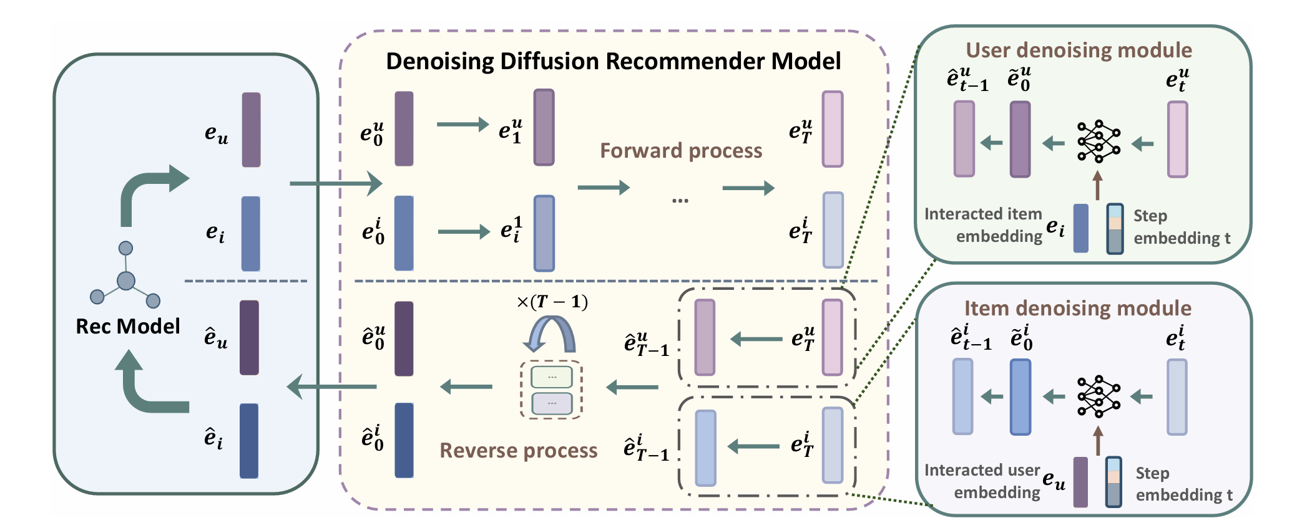
ATAI
Advanced Technique of Artificial Intelligence
ATAI
ChongqingUniversity _{AdvancedTechniqueof}
of Technology Artificial Intelligence
Chongqing University of
Technology
Chongqing University ^{ATAI}
_{of Technology} Advanced Techniqueof
Artificial Intelligence
Chongqing University of Technology
Chongqing University of Technology
Overview

Slide 4
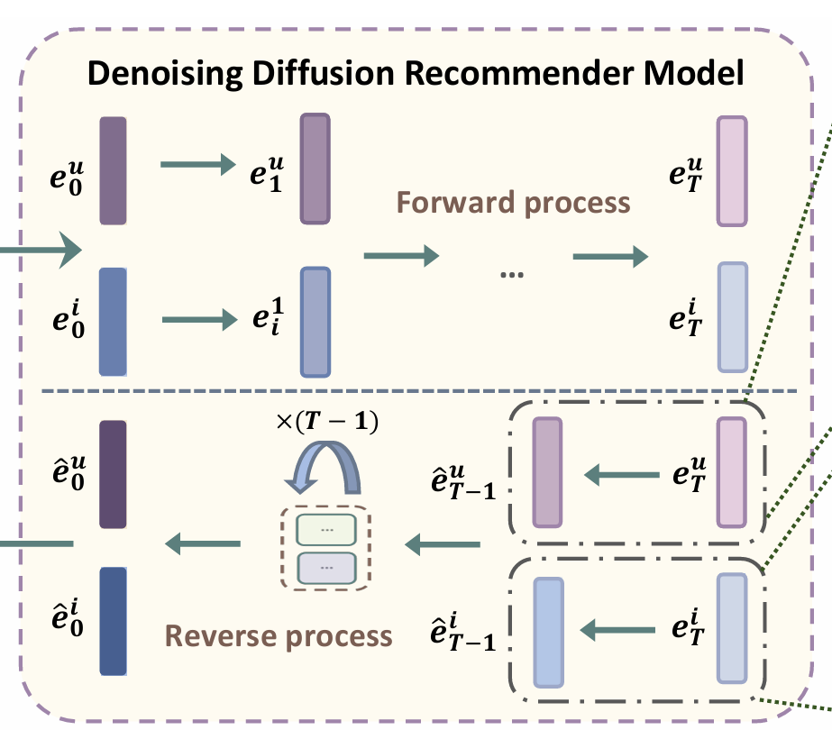
ATAI
Advanced Technique of Artificial Intelligence
ATAI
ChongqingUniversity _{AdvancedTechniqueof}
of Technology Artificial Intelligence
Chongqing University of
Technology
Chongqing University ^{ATAI}
_{of Technology} Advanced Techniqueof
Artificial Intelligence
Chongqing University of Technology
Chongqing University of Technology
Preliminary
Forward process
Reverse process

Slide 5
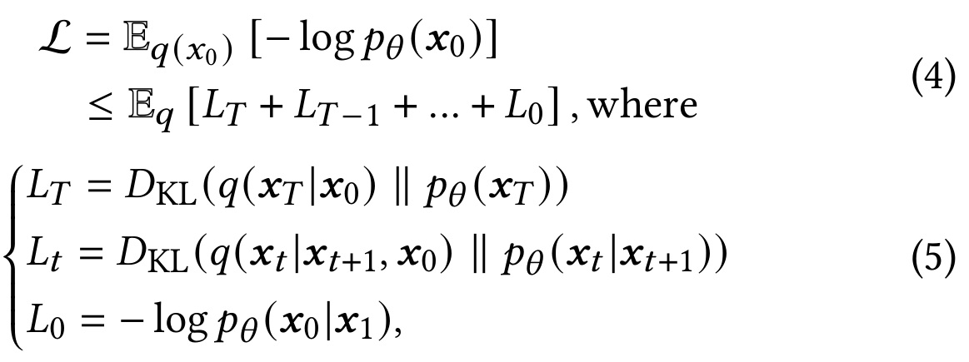
ATAI
Advanced Technique of Artificial Intelligence
ATAI
ChongqingUniversity _{AdvancedTechniqueof}
of Technology Artificial Intelligence
Chongqing University of
Technology
Chongqing University ^{ATAI}
_{of Technology} Advanced Techniqueof
Artificial Intelligence
Chongqing University of Technology
Chongqing University of Technology
Preliminary
Training

Slide 6
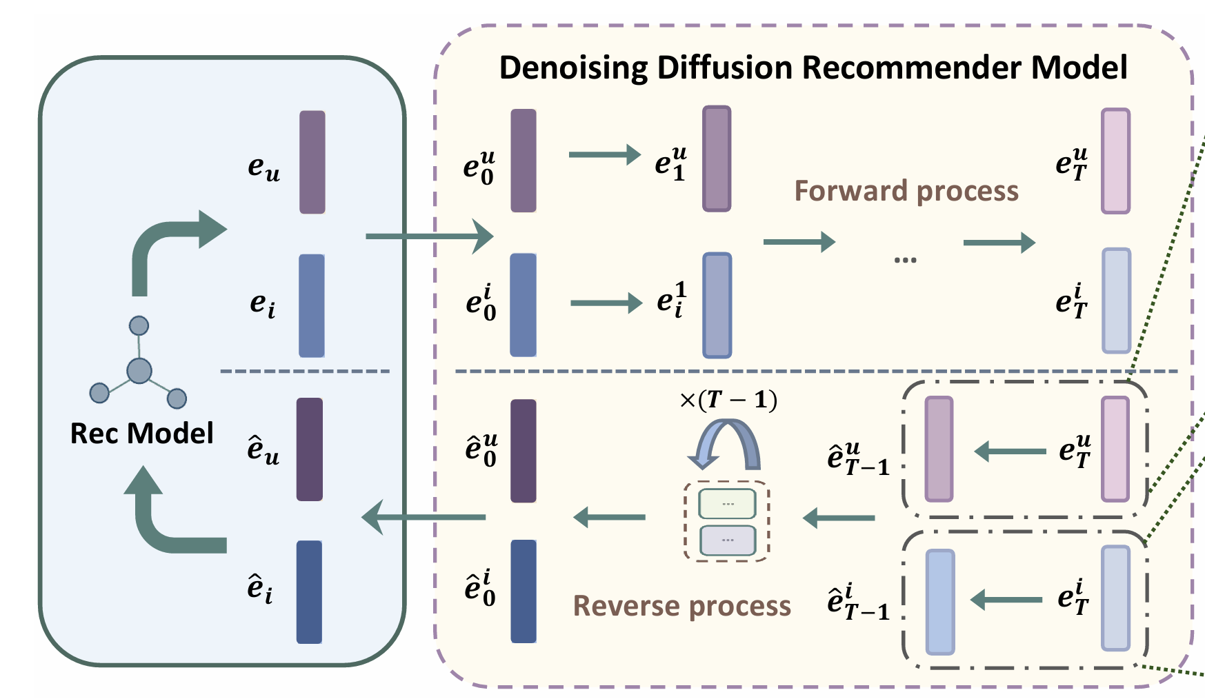
ATAI
Advanced Technique of Artificial Intelligence
ATAI
ChongqingUniversity _{AdvancedTechniqueof}
of Technology Artificial Intelligence
Chongqing University of
Technology
Chongqing University ^{ATAI}
_{of Technology} Advanced Techniqueof
Artificial Intelligence
Chongqing University of Technology
Chongqing University of Technology
Method
Forward process
Reverse process

Slide 7
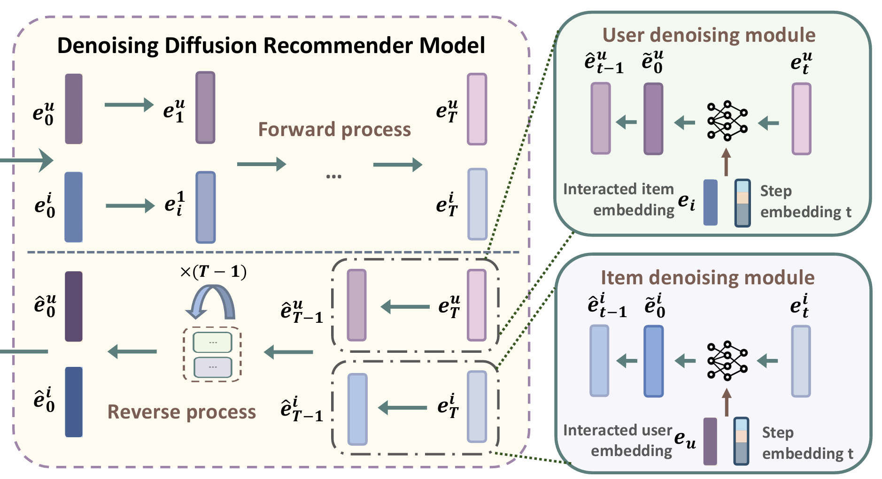
ATAI
Advanced Technique of Artificial Intelligence
ATAI
ChongqingUniversity _{AdvancedTechniqueof}
of Technology Artificial Intelligence
Chongqing University of
Technology
Chongqing University ^{ATAI}
_{of Technology} Advanced Techniqueof
Artificial Intelligence
Chongqing University of Technology
Chongqing University of Technology
Method
Denoisingmodule

Slide 8
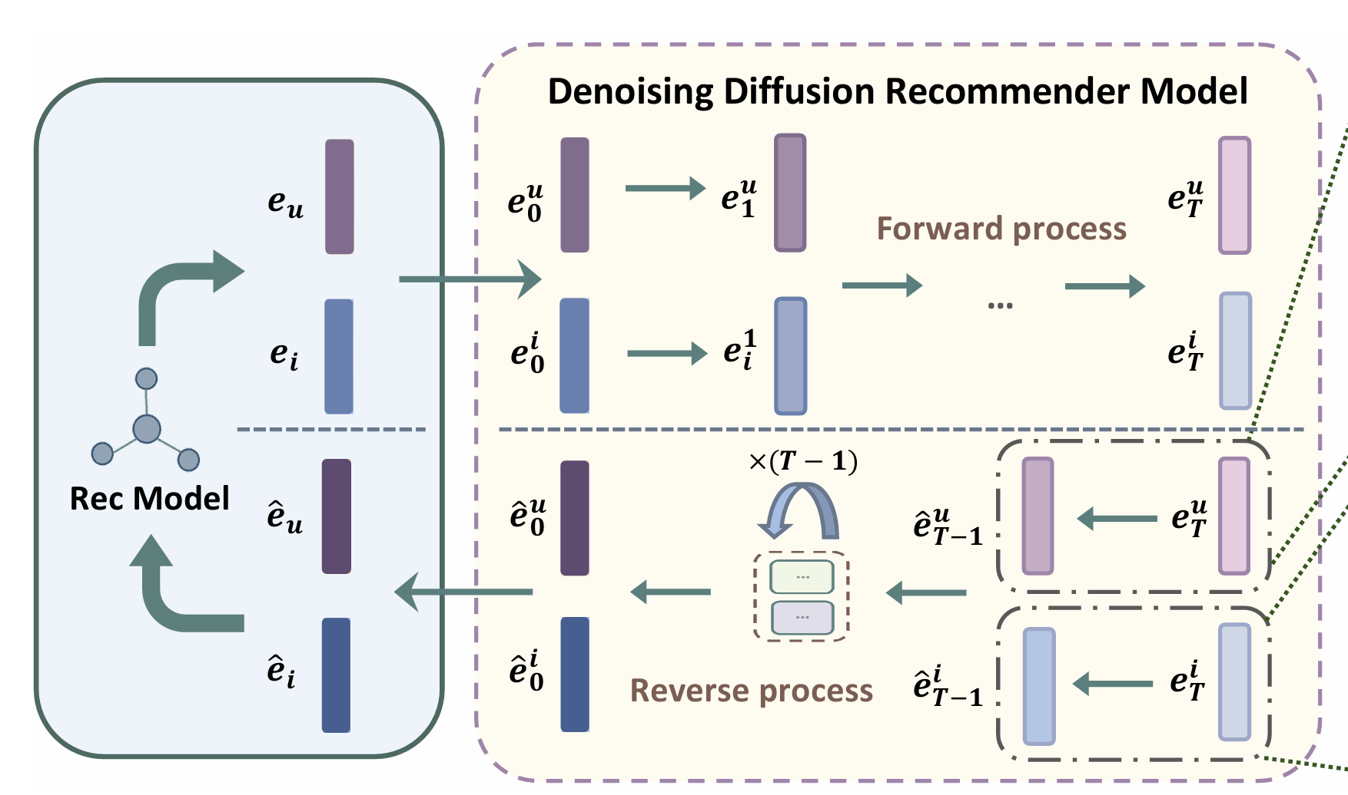
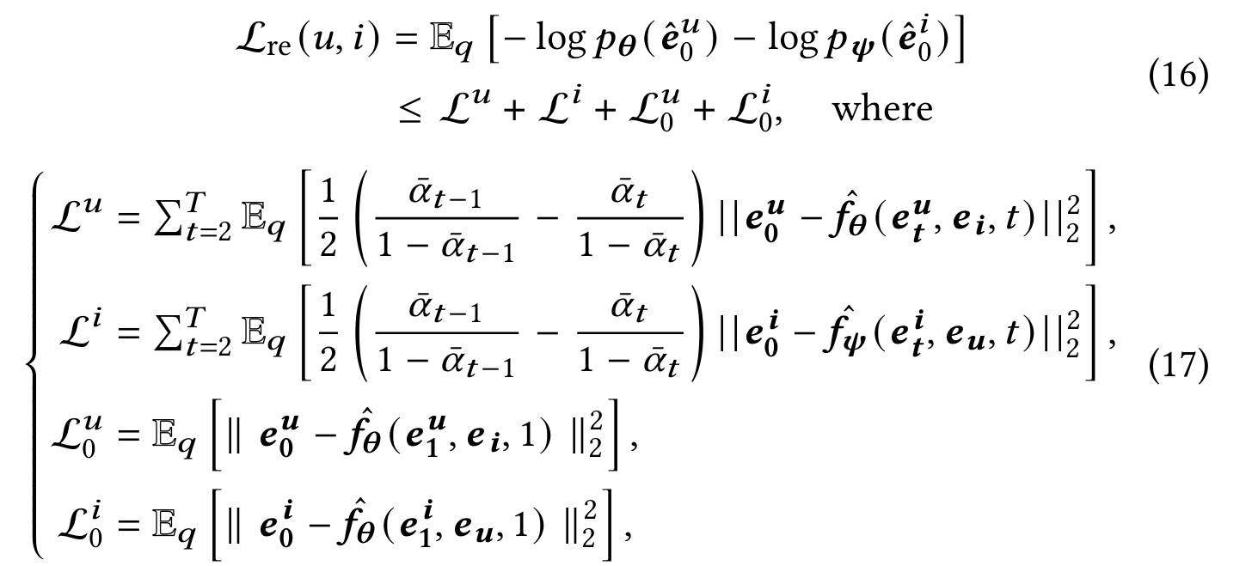
ATAI
Advanced Technique of Artificial Intelligence
ATAI
ChongqingUniversity _{AdvancedTechniqueof}
of Technology Artificial Intelligence
Chongqing University of
Technology
Chongqing University ^{ATAI}
_{of Technology} Advanced Techniqueof
Artificial Intelligence
Chongqing University of Technology
Chongqing University of Technology
Method

Slide 9
ATAI
Advanced Technique of Artificial Intelligence
ATAI
ChongqingUniversity _{AdvancedTechniqueof}
of Technology Artificial Intelligence
Chongqing University of
Technology
Chongqing University ^{ATAI}
_{of Technology} Advanced Techniqueof
Artificial Intelligence
Chongqing University of Technology
Chongqing University of Technology
Method

Slide 10
ATAI
Advanced Technique of Artificial Intelligence
ATAI
ChongqingUniversity _{AdvancedTechniqueof}
of Technology Artificial Intelligence
Chongqing University of
Technology
Chongqing University ^{ATAI}
_{of Technology} Advanced Techniqueof
Artificial Intelligence
Chongqing University of Technology
Chongqing University of Technology
Method

Slide 11
ATAI
Advanced Technique of Artificial Intelligence
ATAI
ChongqingUniversity _{AdvancedTechniqueof}
of Technology Artificial Intelligence
Chongqing University of
Technology
Chongqing University ^{ATAI}
_{of Technology} Advanced Techniqueof
Artificial Intelligence
Chongqing University of Technology
Chongqing University of Technology
Experiments

Slide 12
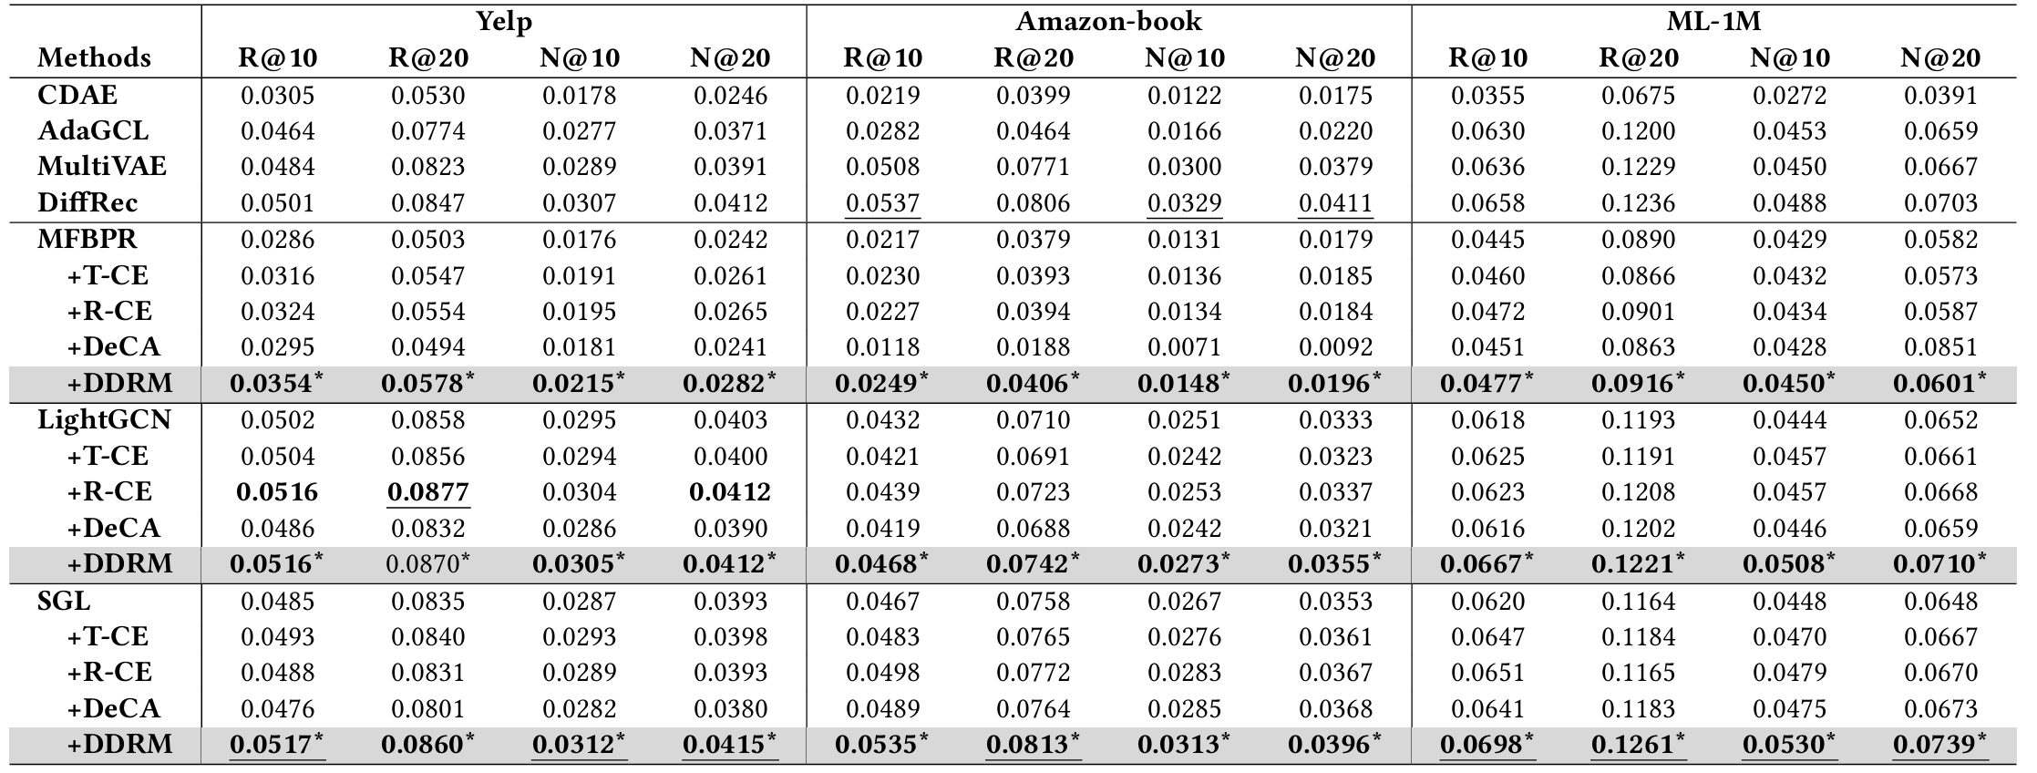
ATAI
Advanced Technique of Artificial Intelligence
ATAI
ChongqingUniversity _{AdvancedTechniqueof}
of Technology Artificial Intelligence
Chongqing University of
Technology
Chongqing University ^{ATAI}
_{of Technology} Advanced Techniqueof
Artificial Intelligence
Chongqing University of Technology
Chongqing University of Technology
Experiments

Slide 13
ATAI
Advanced Technique of Artificial Intelligence
ATAI
ChongqingUniversity _{AdvancedTechniqueof}
of Technology Artificial Intelligence
Chongqing University of
Technology
Chongqing University ^{ATAI}
_{of Technology} Advanced Techniqueof
Artificial Intelligence
Chongqing University of Technology
Chongqing University of Technology
Experiments

Slide 14
ATAI
Advanced Technique of Artificial Intelligence
ATAI
ChongqingUniversity _{AdvancedTechniqueof}
of Technology Artificial Intelligence
Chongqing University of
Technology
Chongqing University ^{ATAI}
_{of Technology} Advanced Techniqueof
Artificial Intelligence
Chongqing University of Technology
Chongqing University of Technology
Experiments

Slide 15
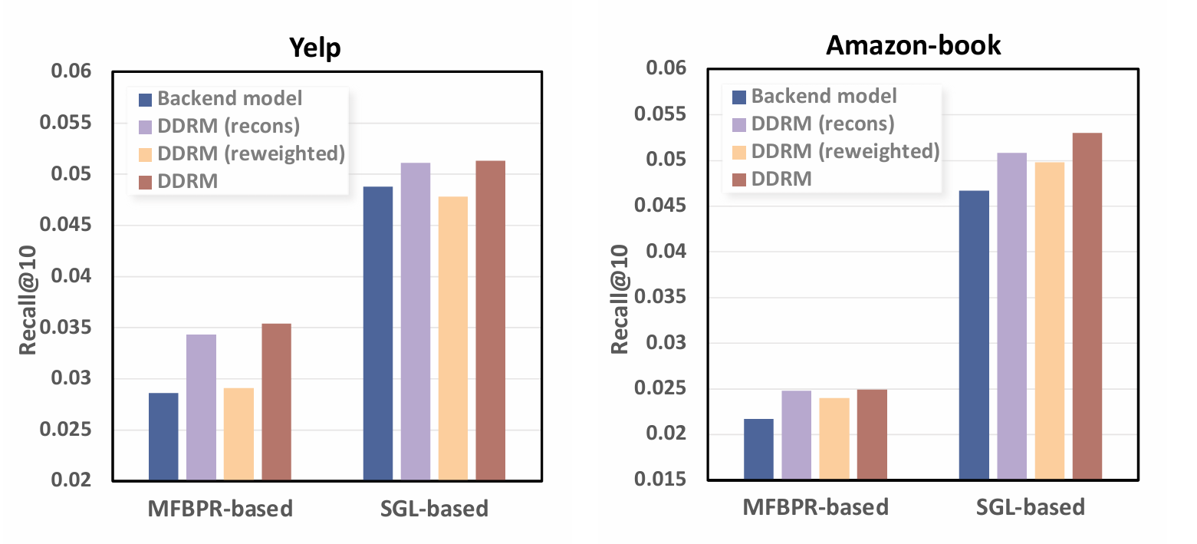
ATAI
Advanced Technique of Artificial Intelligence
ATAI
ChongqingUniversity _{AdvancedTechniqueof}
of Technology Artificial Intelligence
Chongqing University of
Technology
Chongqing University ^{ATAI}
_{of Technology} Advanced Techniqueof
Artificial Intelligence
Chongqing University of Technology
Chongqing University of Technology
Experiments

Slide 16
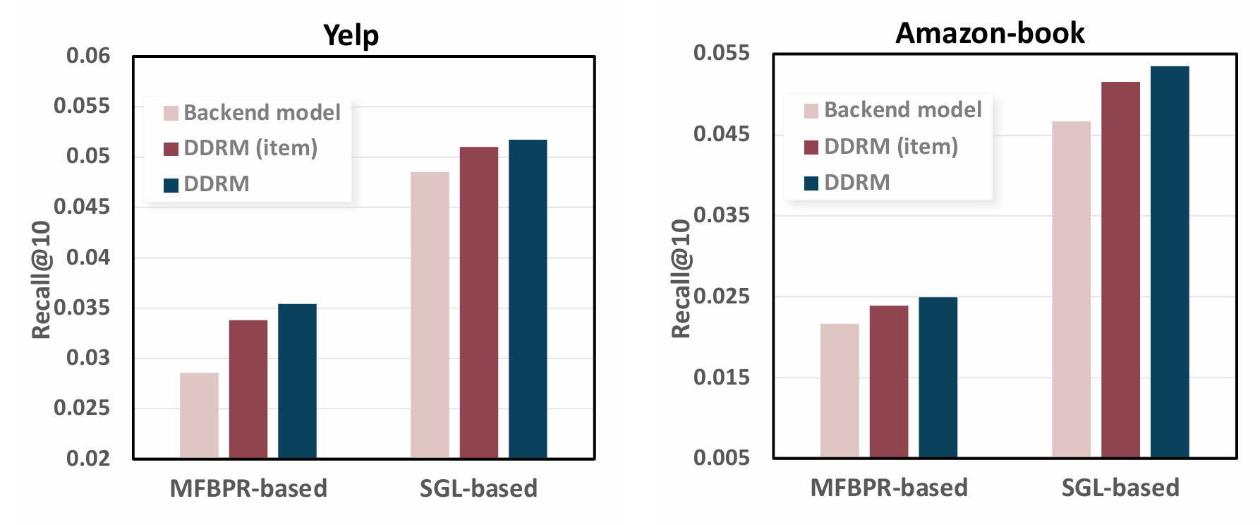
ATAI
Advanced Technique of Artificial Intelligence
ATAI
ChongqingUniversity _{AdvancedTechniqueof}
of Technology Artificial Intelligence
Chongqing University of
Technology
Chongqing University ^{ATAI}
_{of Technology} Advanced Techniqueof
Artificial Intelligence
Chongqing University of Technology
Chongqing University of Technology
Experiments

Slide 17
ATAI
Advanced Technique of Artificial Intelligence
ATAI
ChongqingUniversity _{AdvancedTechniqueof}
of Technology Artificial Intelligence
Chongqing University of
Technology
Chongqing University ^{ATAI}
_{of Technology} Advanced Techniqueof
Artificial Intelligence
Chongqing University of Technology
Chongqing University of Technology
Experiments

Slide 18
ATAI
Advanced Technique of Artificial Intelligence
ATAI
ChongqingUniversity _{AdvancedTechniqueof}
of Technology Artificial Intelligence
Chongqing University of
Technology
Chongqing University ^{ATAI}
_{of Technology} Advanced Techniqueof
Artificial Intelligence
Chongqing University of Technology
Chongqing University of Technology
Thanks!

